Slide 1

Project Title -Seasonal Agriculture Performance Analysis
[Student Name : Mohit Kumar
College Name - Muzaffarpur Institute of Technology ,Muzaffarpur ]
AICTE STU ID : (STU6a6c9fdb13ad51785503707)

Slide 2

PROBLEM STATEMENT
Agricultural activities are influenced by seasonal variations in environmental conditions,
farming practices, resource availability and market conditions. As a result, agricultural
performance may differ from one season to another.
However, raw agricultural data does not clearly explain how agricultural performance changes
across seasons or what patterns can be observed in different seasonal conditions.
The problem is to analyze the given agricultural dataset and investigate seasonal differences
in agricultural performance by identifying meaningful patterns, trends, relationships and
variations within the available data.

Slide 3
Project Description
This project is given student to feel and realise real problem that data anlysist face in real life.
It is problem containing raw agriculture relation data . We have to analyse and process it to give positive outcomes that help stakeholder.
This data contain information related to farming practices, environmental conditions, crop production, resource usage and economic performance.
We have to analyze the given agricultural dataset and investigate seasonal differences in agricultural performance by identifying meaningful patterns, trends, relationships and variations within the available data.
At the end , we have to make report on processed data and give solution
to problems.

Slide 4

WHO ARE THE END USERS?
Agricultural Planners & Government Officials
  Need: Evidence-based seasonal planning and resource allocation (subsidies, seeds, irrigation).
  Value: Data-driven insights to mitigate drought/seasonal risks and improve food security policies.
Farmers & Local Agricultural Advisory Services
  Need: Understanding crop performance trends across varying environmental conditions and seasons.
  Value: Clear guidelines on crop selection, input timing (fertilizers/water), and yield optimization.
Agronomists & Data Researchers
  Need: Exploring hidden correlations between seasonal weather, soil factors, and harvest metrics.
  Value: Cleaned, structured agricultural dataset with statistical relationship insights.

Slide 5

Technology Used
Python – Main programming language used for data analysis.
Google Colab / Jupyter Notebook – Environment used to write and execute Python code.
Pandas – Used for loading, cleaning, filtering, and analyzing the CSV dataset.
NumPy – Used for numerical calculations and data processing.
Matplotlib – Used to create graphs and visualizations.
CSV – File format used to store the Seasonal Agriculture Performance dataset.
Data Analysis & Visualization – Techniques used to find trends.

Slide 6
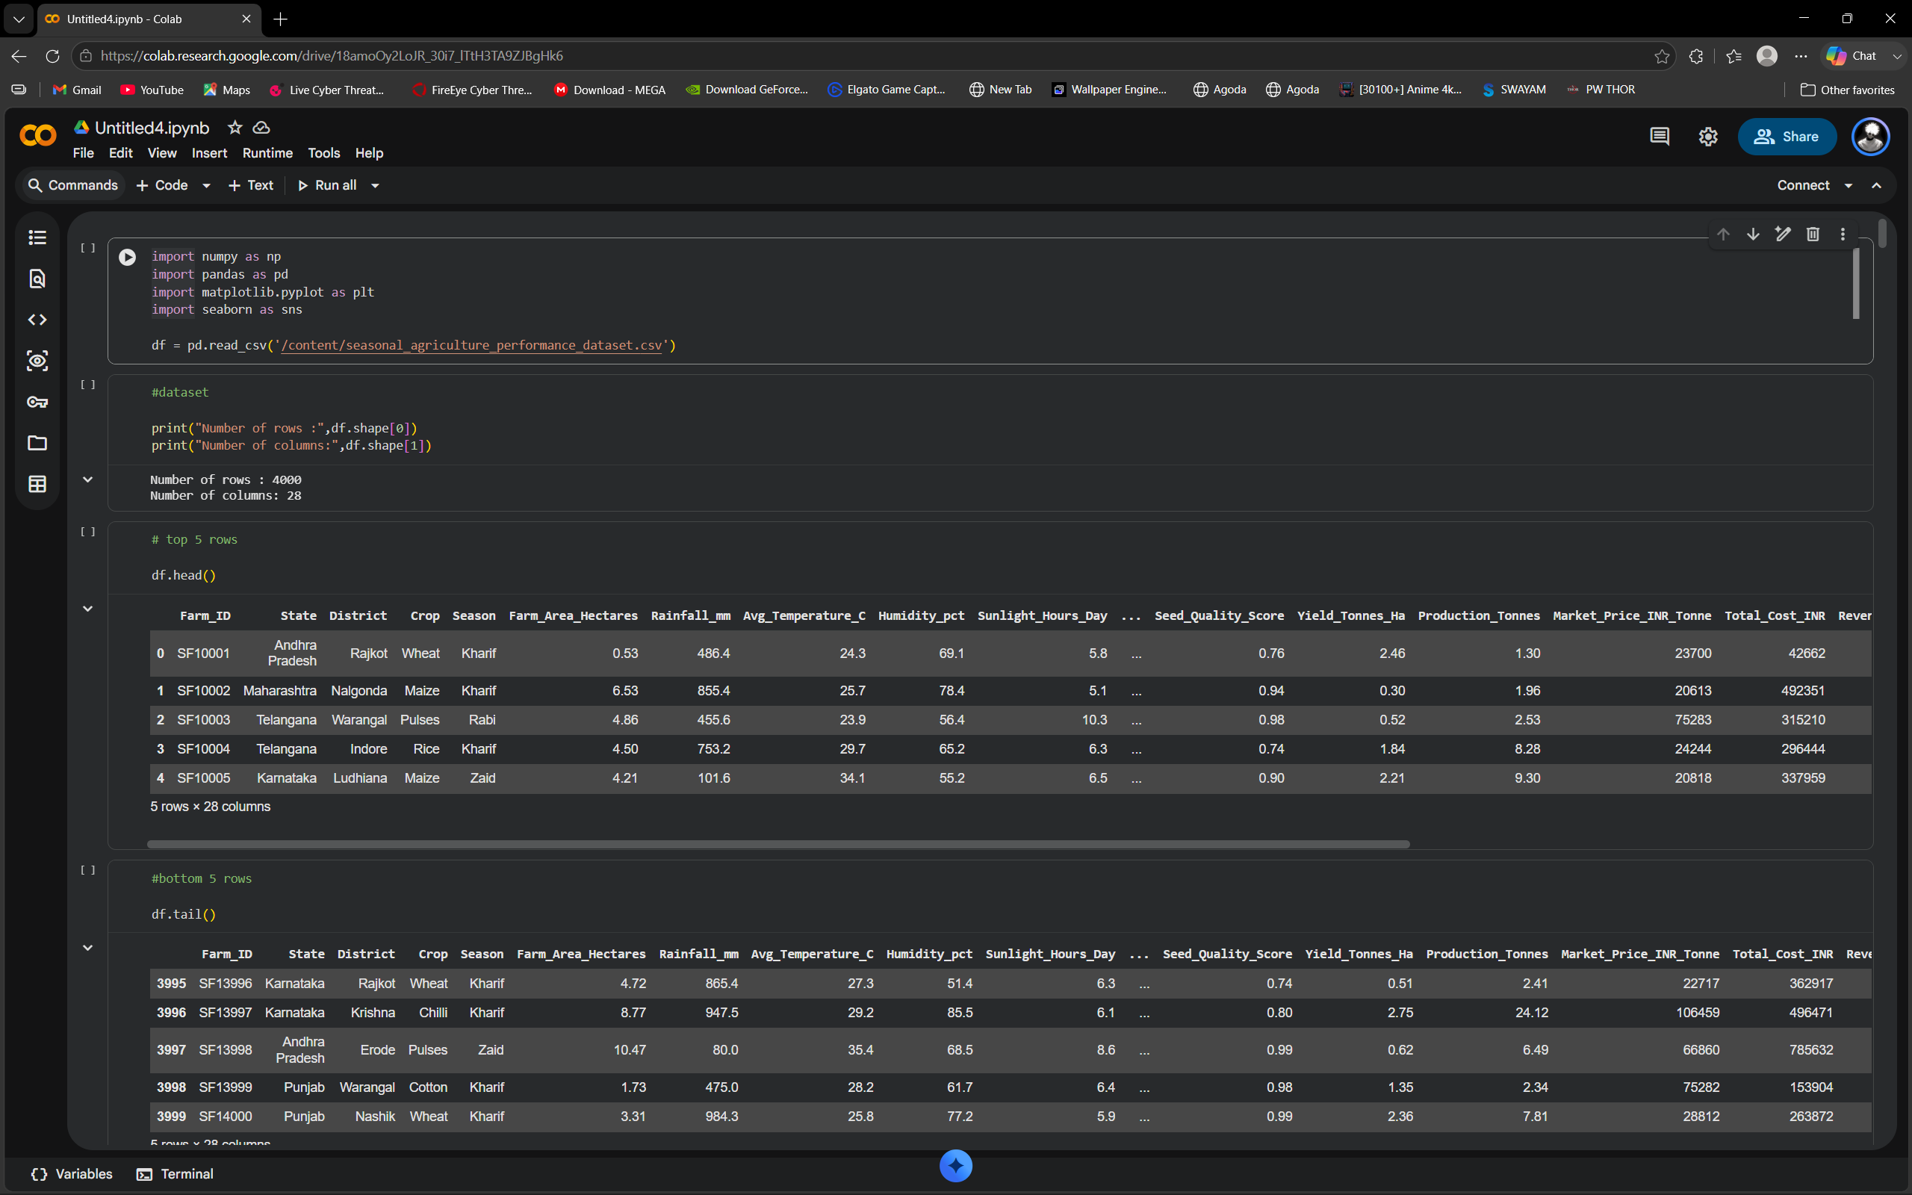
RESULTS

Slide 7
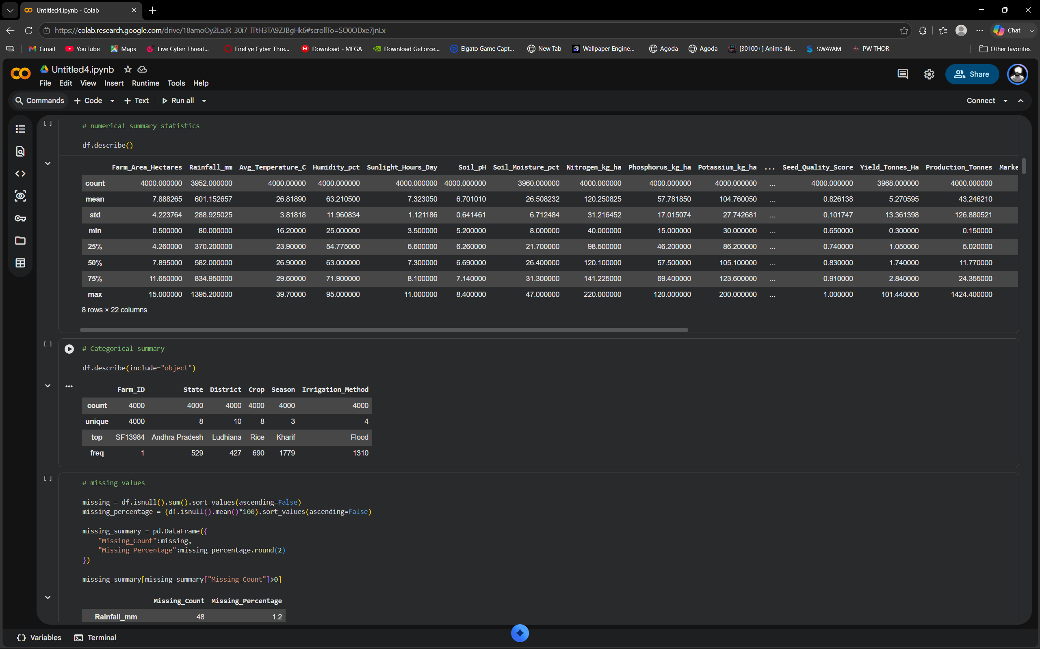
RESULTS
[Add screen shots of your code ]

Slide 8
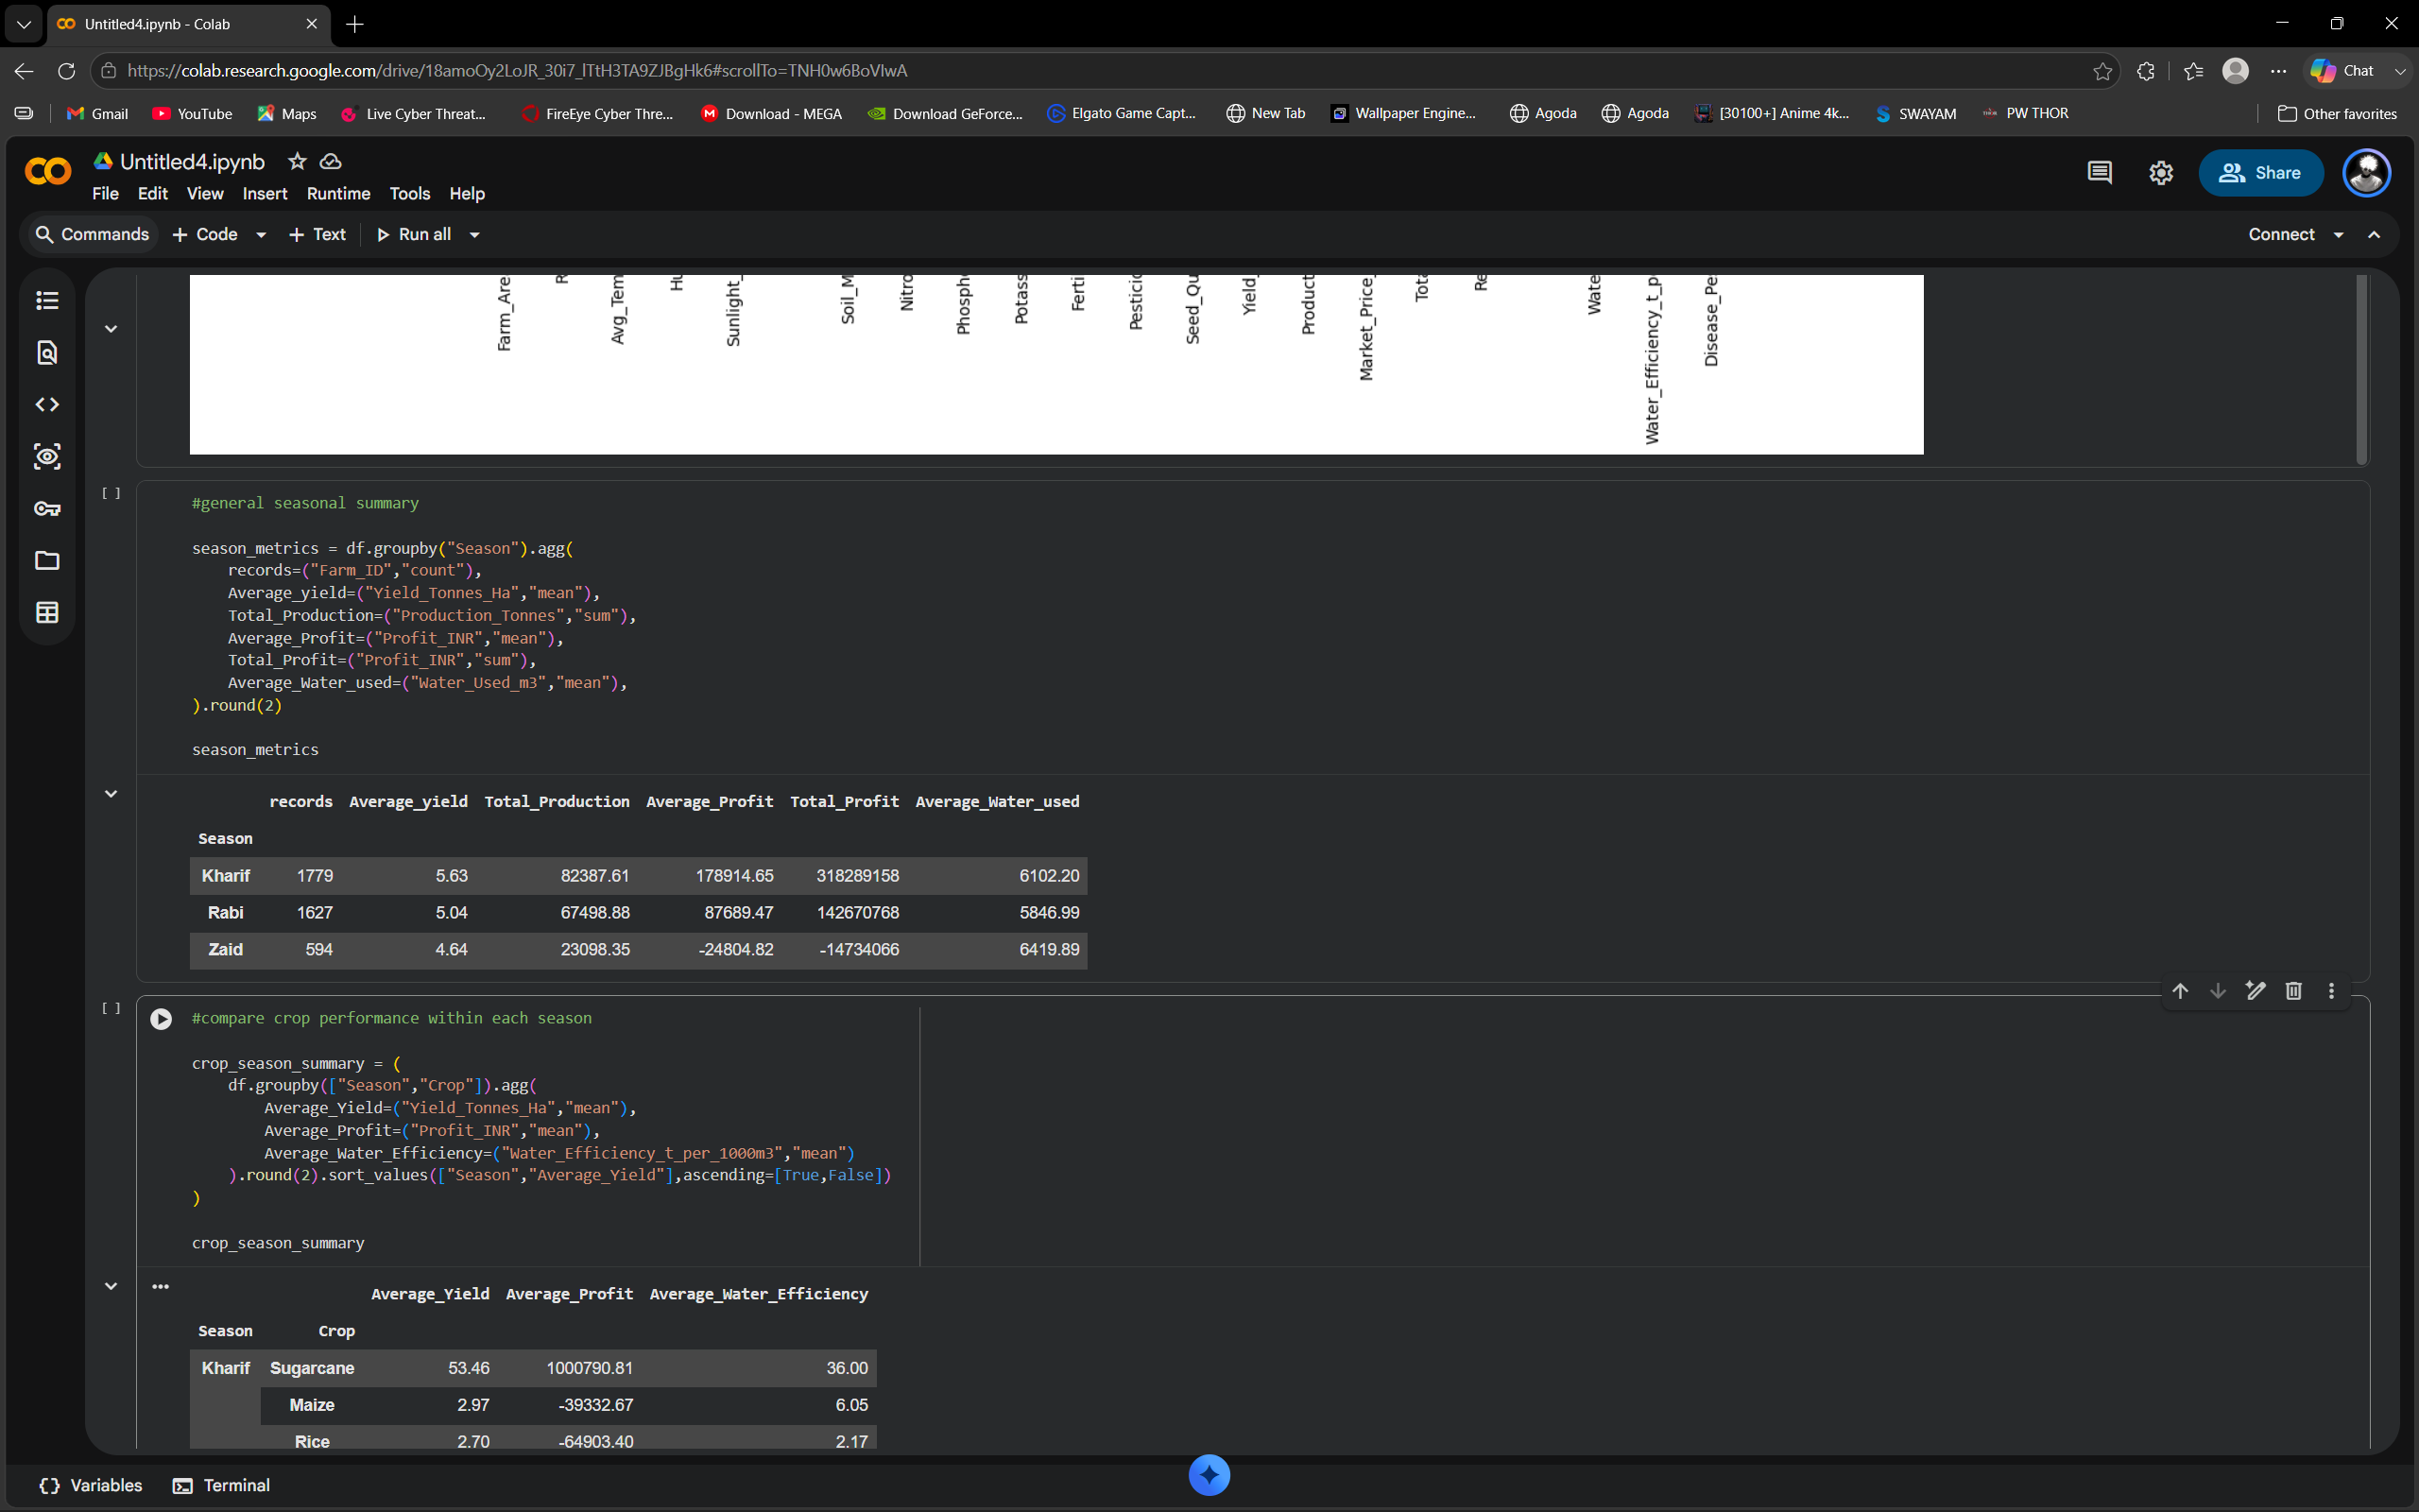
RESULTS
[Add screen shots of your code ]

Slide 9
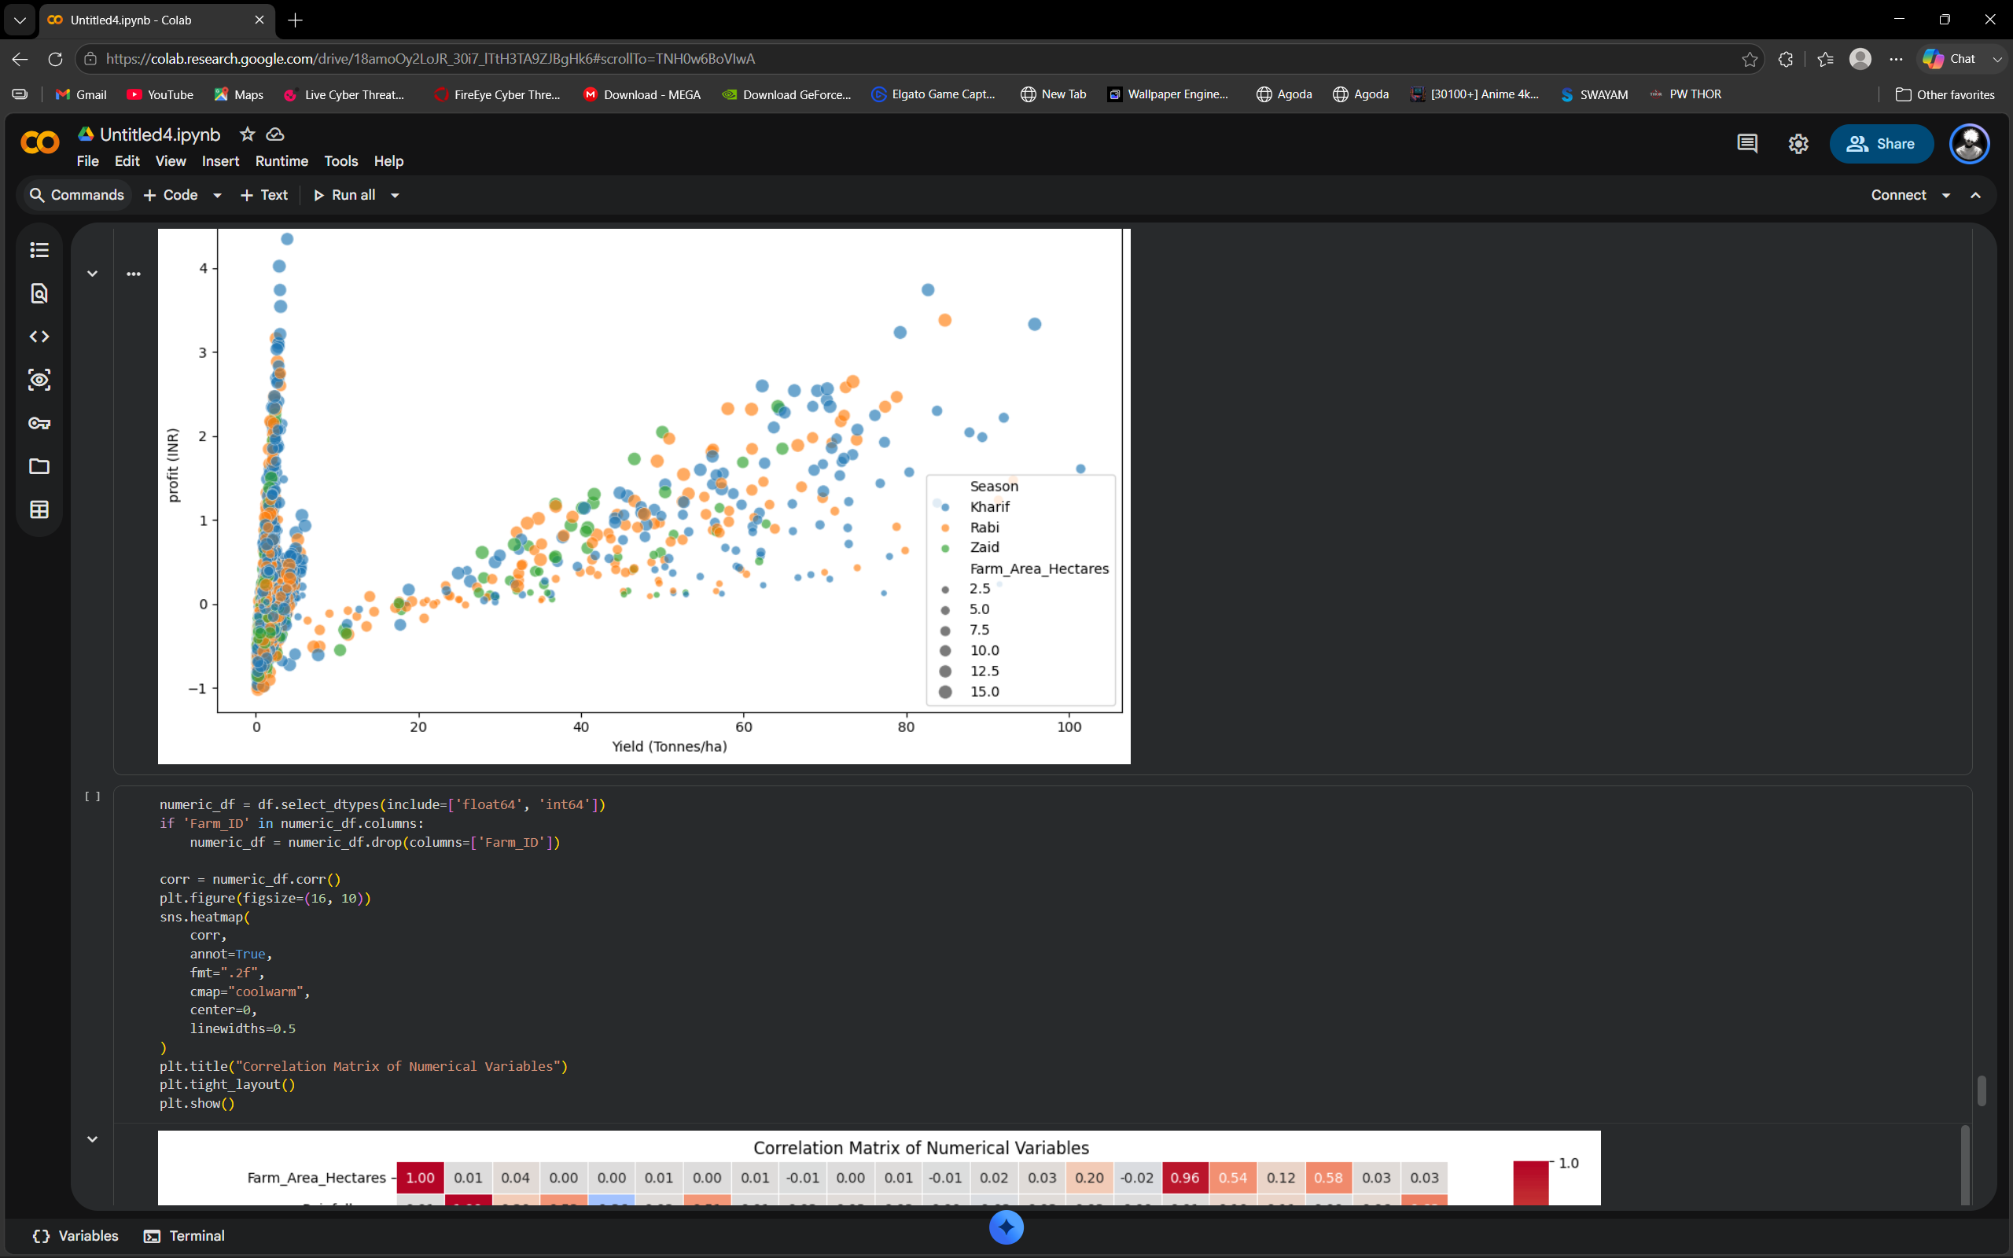
RESULTS
[Add screen shots of your code ]

Slide 10
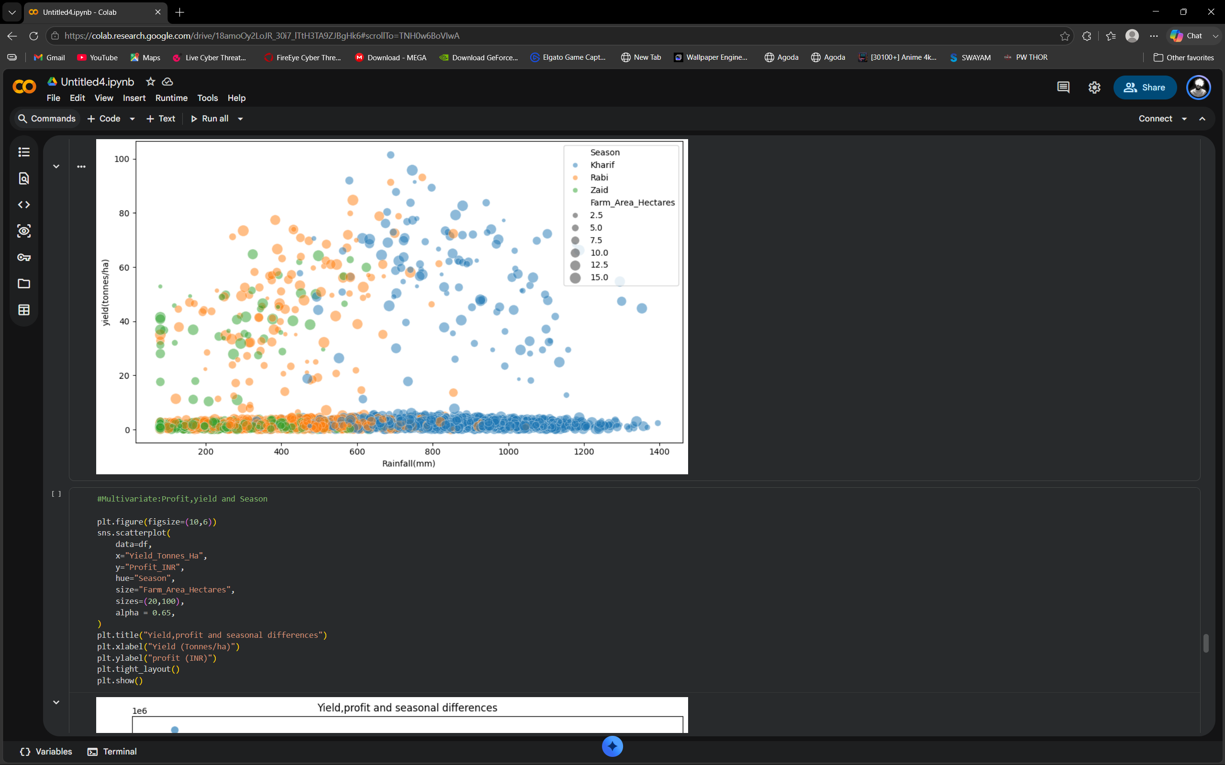
RESULTS
[Add screen shots of your code ]

Slide 11
Future scope
Predictive Yield & Profit Modelling:
  Transitioning from descriptive analysis to machine learning algorithms to predict crop yields and profitability based on pre-season soil and weather forecasts.
IoT & Real-Time Sensor Integration:
  Connecting the analytical framework directly to IoT field sensors for live monitoring and automated precision irrigation alerts.
Smart Resource Optimization Engines:
  Developing optimization models that suggest optimal fertilizer mix and irrigation methods to maximize Water Efficiency while minimizing production costs.
Climate Change Volatility Simulation:
  Simulating extreme weather scenarios to evaluate farm resilience and crop vulnerability across seasons.
Interactive GIS & Regional Dashboard:
  Expanding the project into a geospatial dashboard that lets regional agricultural officers visualize crop performance metrics interactively by state and district.

Slide 12
GitHub Link
GITHUB LINK

Slide 13

VOIS Course completion certificate -
Course name- Data Visualization

Slide 14
Thank you
.
.

